Slide 1
Programming II
(C Programming Language)
Loops in C
(Part I)
Lecture 7, Monday February 15, 2021
Dr. Ayman ALJARBOUH

Slide 2
Outline
Loops in C
for Loop in C
while Loop in C
do…while Loop in C
Nested Loops in C

Slide 3
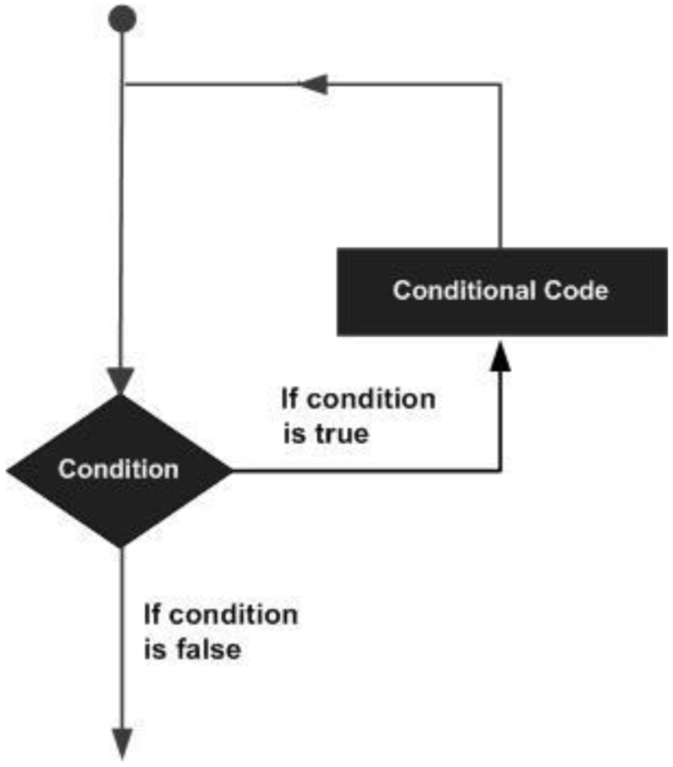
Loops in C
A loop statement allows us to execute a statement or group of statements multiple times
The flowchart of a loop

Slide 4
Outline
Loops in C
for Loop in C
while Loop in C
do…while Loop in C
Nested Loops in C

Slide 5
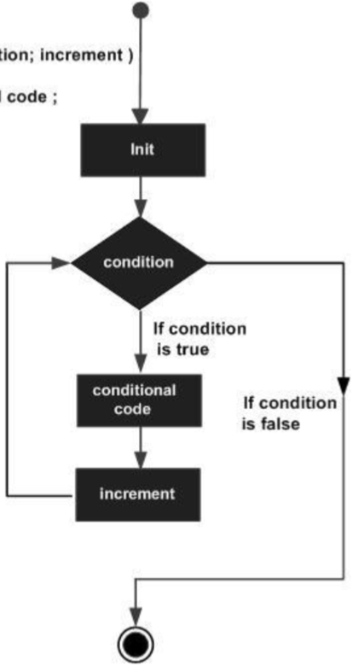
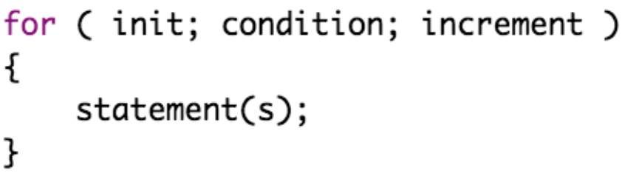
for Loop in C
The for loop is used to iterate over a sequence
The syntax of for loop in C is:
The flowchart of for loop

Slide 6
for Loop in C
The for loop is used to iterate over a sequence
The syntax of for loop in C is:
The init step allows you to declare and initialize any loop control variables
The flowchart of for loop

Slide 7
for Loop in C
The for loop is used to iterate over a sequence
The syntax of for loop in C is:
The condition is evaluated: If it is true, the body of the loop is executed. If it is false, the body of the loop does not execute
The flowchart of for loop

Slide 8
for Loop in C
The for loop is used to iterate over a sequence
The syntax of for loop in C is:
After each iteration, the flow of control jumps back up to the increment statement
The flowchart of for loop

Slide 9
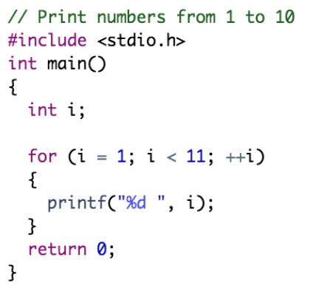
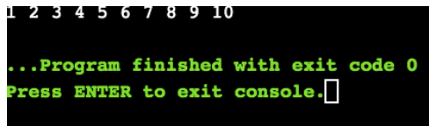
for Loop in C
Example:
Output:
In this program:
The variable i is initialized to 1.
The condition i < 11 is true, the body of for loop is executed.
The update statement ++i is executed. Now, the value of i will be 2. Again, the test expression is true, and the body of for loop is executed.
This process goes on until i becomes 11.
When i becomes 11, i < 11 will be false, and the for loop terminates.

Slide 10
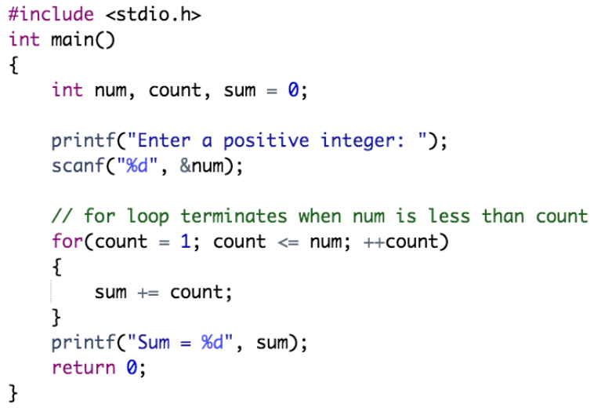
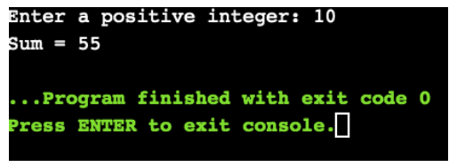
for Loop in C
Example:
Output:
In this program:
The count is initialized to 1 and the condition count<=num is true, the body of for loop is executed and the value of sum will equal to 1.
The update statement ++count is executed. Again, the condition count<=num is true and the body of for loop is executed. Now, the sum will be equal to 3. This process goes on and the sum is calculated until the count reaches 11.
When the count is 11, the condition count<=num is false, and the loop terminates.

Slide 11
Outline
Loops in C
for Loop in C
while Loop in C
do…while Loop in C
Nested Loops in C

Slide 12
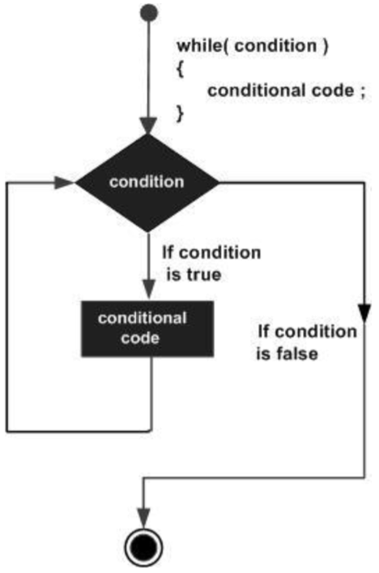
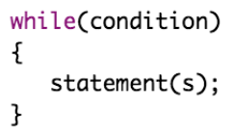
while Loop in C
A while loop executes statements as long as a condition is true
The syntax of while loop in C is:
The flowchart of while loop

Slide 13
while Loop in C
A while loop executes statements as long as a condition is true
The syntax of while loop in C is:
The condition may be any expression, and true is any nonzero value
The flowchart of while loop

Slide 14
while Loop in C
A while loop executes statements as long as a condition is true
The syntax of while loop in C is:
The loop iterates while the condition is true
The flowchart of while loop

Slide 15
while Loop in C
A while loop executes statements as long as a condition is true
The syntax of while loop in C is:
The process goes on until the condition is evaluated to false
The flowchart of while loop

Slide 16
while Loop in C
A while loop executes statements as long as a condition is true
The syntax of while loop in C is:
If the condition is false, the loop terminates
The flowchart of while loop

Slide 17
while Loop in C
A while loop executes statements as long as a condition is true
The syntax of while loop in C is:
If the condition is false, the loop terminates
The flowchart of while loop

Slide 18
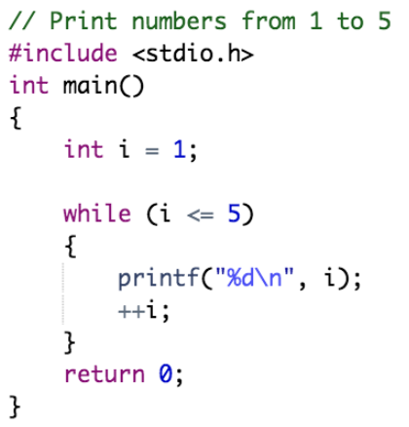
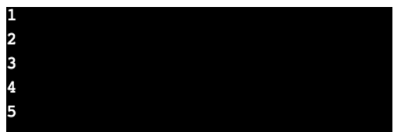
while Loop in C
Example:
Output:
In this program:
The variable i is initialized to 1.
When i is 1, the expression i <= 5 is true. Hence, the body of the while loop is executed. This prints 1 on the screen and the value of i is increased to 2.
The test expression i <= 5 is again true. The body of the while loop is executed again. This prints 2 on the screen and the value of i is increased to 3.
This process goes on until i becomes 6.
When i is 6, the test expression i <= 5 will be false and the loop terminates.

Slide 19
Outline
Loops in C
for Loop in C
while Loop in C
do…while Loop in C
Nested Loops in C

Slide 20
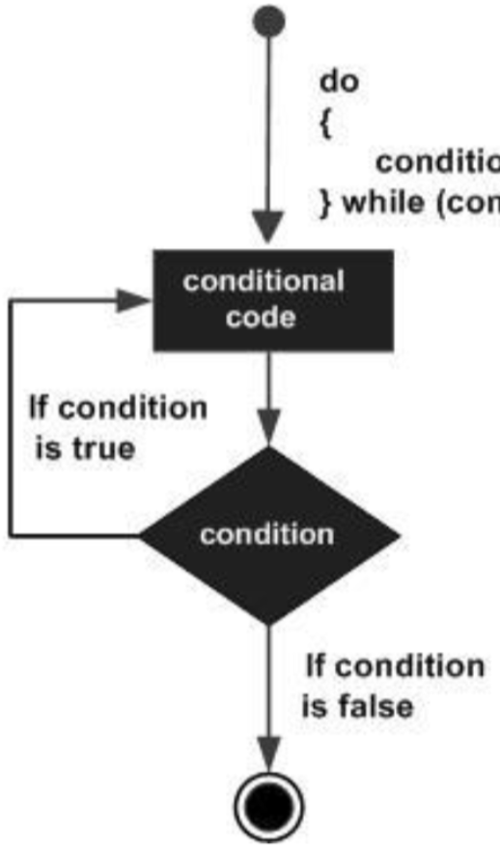
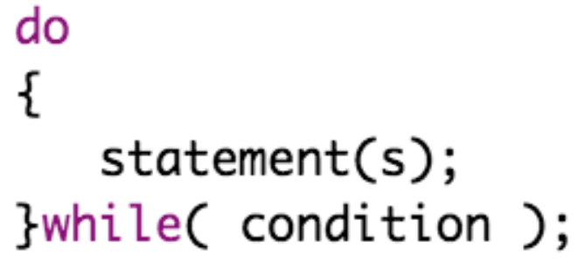
do…while Loop in C
The do...while loop checks the condition at the bottom of the loop
The syntax of do...while loop in C is:
The flowchart of do…while loop

Slide 21
do…while Loop in C
The do...while loop checks the condition at the bottom of the loop
The syntax of do...while loop in C is:
The condition appears at the end of the loop, so the statement(s) in the loop execute once before the condition is tested
The flowchart of do…while loop

Slide 22
do…while Loop in C
The do...while loop checks the condition at the bottom of the loop
The syntax of do...while loop in C is:
If the condition is true, the control jumps back up to do and the statement(s) in the loop execute again, and the test expression is evaluated
The flowchart of do…while loop

Slide 23
do…while Loop in C
The do...while loop checks the condition at the bottom of the loop
The syntax of do...while loop in C is:
This process repeats until the given condition becomes false
The flowchart of do…while loop

Slide 24
do…while Loop in C
The do...while loop checks the condition at the bottom of the loop
The syntax of do...while loop in C is:
If the condition is false, the loop terminates (ends)
The flowchart of do…while loop

Slide 25
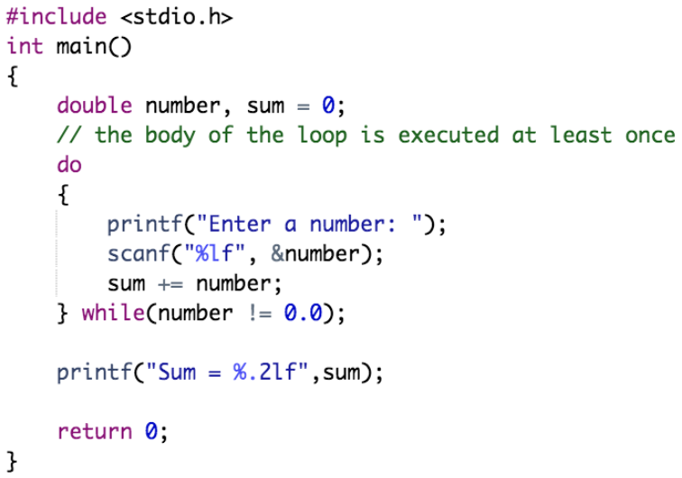
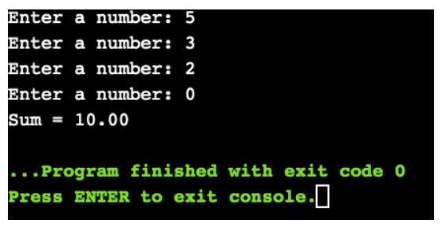
do…while Loop in C
Example:
Output:

Slide 26
Outline
Loops in C
for Loop in C
while Loop in C
do…while Loop in C
Nested Loops in C

Slide 27
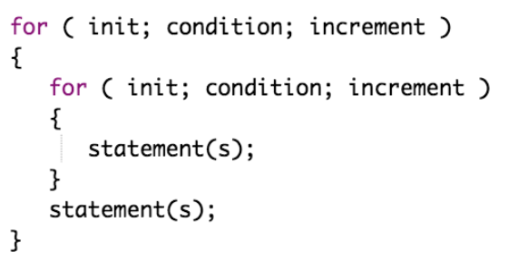
Nested Loops in C
C programming language allows to use one loop inside another loop
The syntax for a nested for loop statement is:

Slide 28
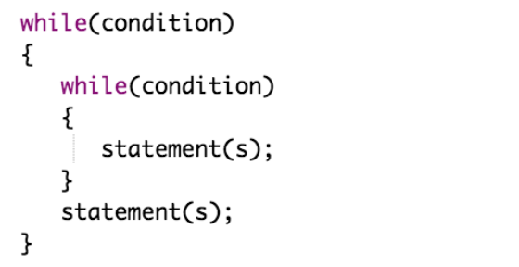
Nested Loops in C
C programming language allows to use one loop inside another loop
The syntax for a nested while loop statement is:

Slide 29
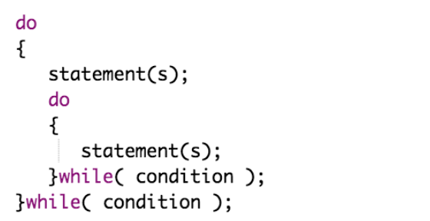
Nested Loops in C
C programming language allows to use one loop inside another loop
The syntax for a nested do…while loop statement is:

Slide 30
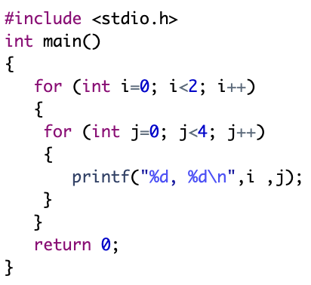
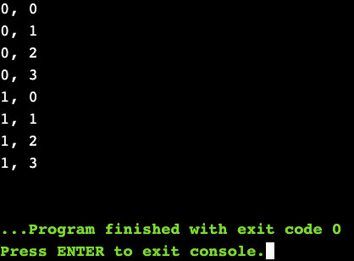
Nested Loops in C
Example:
Output:

Slide 31
Practical Exercises
Write and Compile the following C programs:
Program 1:

Slide 32
Practical Exercises
Write and Compile the following C programs:
Program 2:

Slide 33
Practical Exercises
Write and Compile the following C programs:
Program 3:

Slide 34
Practical Exercises
Write and Compile the following C programs:
Program 4:

Slide 35
Practical Exercises
Write and Compile the following C programs:
Program 5:

